Slide 1
Java Applet
In JAVA we write two types of programs or applications-
Standalone applications- is one which runs in the context of local disk and whose result is not sharable. Every standalone application runs from command prompt and it contains main method along with System.out.println statements.
Distributed application- is one which runs in the context of browser or World Wide Web and it can be accessed across the globe. it does not contain main methods and System.out.println statements.

Slide 2
Contd..
An applet is a JAVA program which runs in the context of browser or World Wide Web.
They can be transmitted over the internet from one computer to another and run using appletViewer or any java supported web browser.
Category of an Applet –
Local Applet
Remote Applet

Slide 3
Local Applet
An applet developed locally and stored into local system or own machine is known as local applet
Local Applet
CPU
Notes:
When A web page trying to find out a local applet. It does not need to use the Internet connection . It simply search the directories in the local system and locates and loads the specified applet.

Slide 4
Remote Applet
A remote applet is that which is developed by someone else and stored on a remote computer connected to the internet
Internet
Remote Applet
Local Computer
Remote Computer
Notes:
In order to locate and load remote applet we must know the applet’s address on the web. This address is known as Uniform resource Locator and must specify in the HTML’s document.

Slide 5
Applet Life Cycle
In a applet life cycle contain four stages
Born on Initialization State
Running State
Idle State.
Dead State.
Born
Start()
Stop()
Display
Running
Idle
Start()
Paint()
Destroy()
Dead

Slide 6
init method()
This is the method which is called by the browser only one time after loading the applet. In this method we write some block of statements which will perform one time operations, such as, obtaining the resources like opening the files, obtaining the database connection, initializing the parameters, etc.
Syntax- public void init()
{
//do initialization or write code that execute one //time
}

Slide 7
start method()
After calling the init method, the next method which is from second request to sub-sequent requests the start method only will be called i.e., start method will be called each and every time. In this method we write the block of statement which provides business logic.
Syntax- public void start()
{
//Actual applet code
}

Slide 8
Stop() method
This is the method which is called by the browser when we minimize the window. In this method we write the block of statements which will temporarily releases the resources which are obtained in init method.
Syntax-public void stop()
{
//Background computation code
}

Slide 9
destroy() method
This is the method which will be called by the browser when we close the window button or when we terminate the applet application. In this method we write same block of statements which will releases the resources permanently which are obtained in init() method.
Syntax- public void destroy()
{
//consist resource release coding
}

Slide 10
paint() method
This method is defined by the AWT and must be overridden by the applet. paint( ) is called each time that the applet must redisplay its output. The paint( ) method has one parameter of type Graphics. This parameter contains the graphics context, which describes the graphics environment in which the applet is running
Syntax- public void paint(Graphics G)
{
//Anything display as output on window
}
Notes:
Inside paint( ) is a call to drawString( ), which is a member of the Graphics class. This method outputs a string beginning at the specified X,Y location

Slide 11
STEPS for developing APPLET PROGRAM:
Import java.applet.Applet package.
Choose the user defined class that must extends java.applet.Applet class and ensure the modifier of the class must be public.
Overwrite the life cycle methods of the applet if require.
Save the program and compile.
Run the applet: To run the applet we have two ways , there are-
Using applet viewer tool.
Using HTML program

Slide 12
Using appletviewer
Appletviewer is a tool supplied by SUN micro system to run the applet programs from the command prompt (in the case of browser is not supporting)
Syntax: appletviewer filename.java
For example:
appletviewer Ex_Applet.java.

Slide 13
Contd..
When we use appletviewer to run the above applet, Ex_Apple.java program must contain the following tag within the multi line comment.
/*<applet code=“Ex_Applet” height=300 width=300> </applet>*/
Write a applet code that can display “Hello Java”.
import java.applet.Applet;
//import java.awt.*;
/*<applet code= "Ex_Applet" height=300 width=300> </applet>*/
public class Ex_Applet extends Applet
{
public void paint(java.awt.Graphics g)
{
g.drawString (“Hello World", 20, 15);
}
}

Slide 14
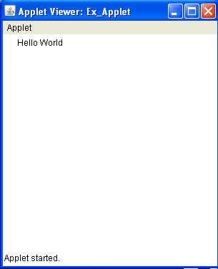
Contd..
Complile the source file
i.e. javac Ex_Applet.java
Run using appletviewer
i.e. appletviewer Ex_Applet.java

Slide 15
Write a JAVA program which illustrates the life cycle methods of applet?
import java.applet.*;
import java.awt.*;
/*<applet code="Ex_Applet" height=300 width=300> </applet>*/
public class Ex_Applet extends Applet
{
String s=" ";
public void init ()
{
setBackground (Color.green);
setForeground (Color.red);
s=s+"1) INIT ";
}

Slide 16
public void start ()
{
s=s+“2) START ";
System.out.println(s);
}
public void stop ()
{
s=s+“3) STOP ";
}

Slide 17
public void destroy ()
{
s=s+“4) DESTROY ";
System.out.println(s);
}
public void paint (Graphics g)
{
Font f=new Font ("arial", Font.BOLD, 40);
g.setFont (f);
g.drawString (s,100,100);
}}//End of Ex_Applet1

Slide 18
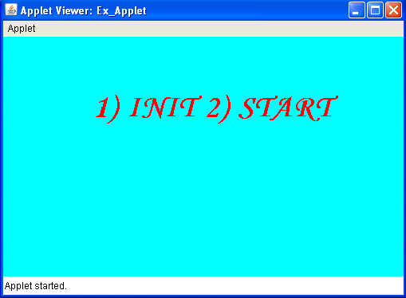
Output

Slide 19
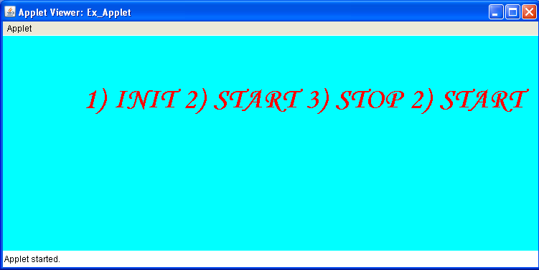
Now minimize and then maximize the applet window

Slide 20
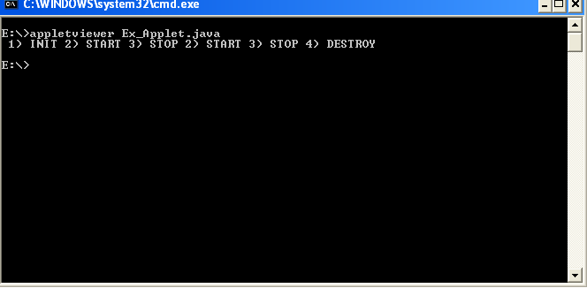
If you click on the close button

Slide 21
Method Description
void setBackground(Color newColor)
To set the background color of an applet’s window
void setForeground(Color newColor)
To set the Text color
You can obtain the current settings for the background and
foreground colors by calling
Color getBackground( )
Color getForeground( )
Color.gray | Color.black | Color.orange | Color.darkGray | Color.yellow
Color.green | Color.magenta | Color.cyan | Color.red
Color.lightGray | Color.blue | Color.pink | Color.white

Slide 22
Using the Status Window
In addition to displaying information in its window, an applet can
also output a message to the status window of the browser or
applet viewer on which it is running. To do so, call showStatus( )
with the string that you want displayed.

Slide 23
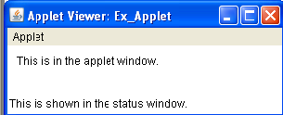
import java.awt.*;
import java.applet.*;
/*
<applet code="Ex_Applet" width=300 height=50> </applet>*/
public class Ex_Applet extends Applet{
public void paint(Graphics g) {
g.drawString("This is in the applet window.", 10, 20);
showStatus("This is shown in the status window.");
}
}

Slide 24
Using HTML
It is mainly used for web page designing in the client machine
HTML Tags and Their Functions
<HTML>…..</HTML> | Signifies the beginning and end of a HTML file
<HEAD>…..</HEAD> | The tag may include details about Web Page. Usually contains <TITLE> tag within it
<TITLE>……</TITLE> | The text contained it will appear in the title bar of the browser
<APPLET>….</APPLET> | APPLET tag declares the applet details as its attributes
<PARAM…> | Use to define user define parameters. The <PARAM..> tag need to place between the applet tags

Slide 25
Contd..
<HTML>
<HEAD>
<TITLE>My company web page</TITLE>
</HEAD>
<BODY BGCOLOR="CYAN">
<FONT SIZE=25 FACE="Monotype Corsiva">Append the applet code in body</FONT>
<>
</BODY>
</HTML>

Slide 26
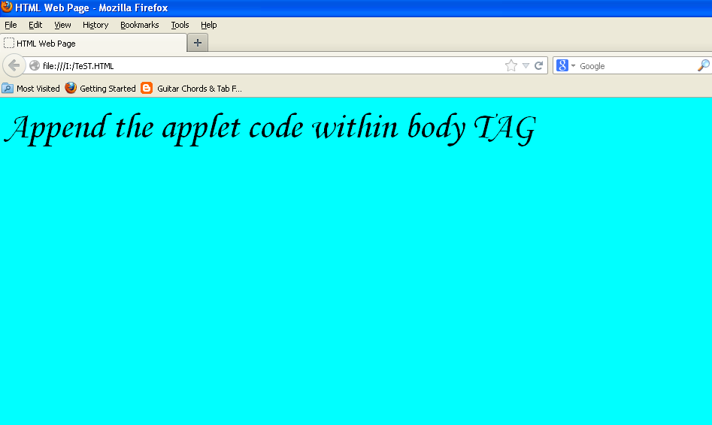

Slide 27
<HTML>
<HEAD>
<TITLE>HTML Web Page</TITLE>
</HEAD>
<BODY BGCOLOR="CYAN">
<FONT SIZE=25 FACE="Monotype Corsiva">Append the applet code within body TAG</FONT>
<applet code= "Ex_Applet" height=200 width=300> </applet>
</BODY>
</HTML>

Slide 28
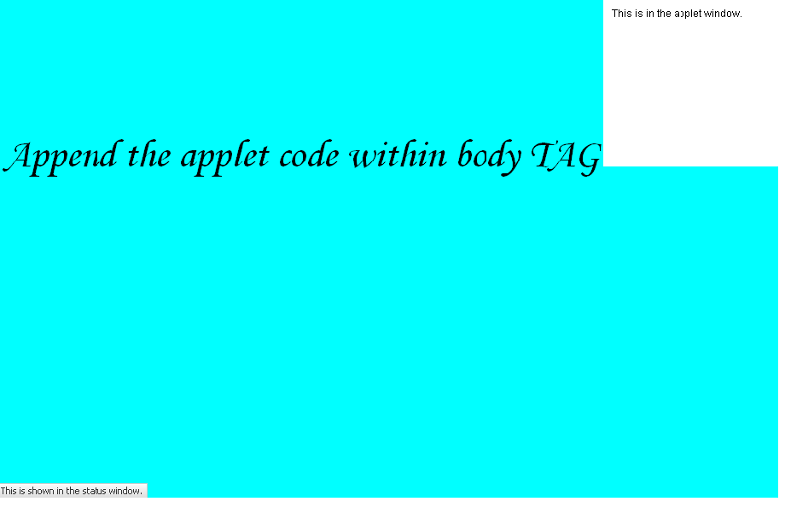

Slide 29
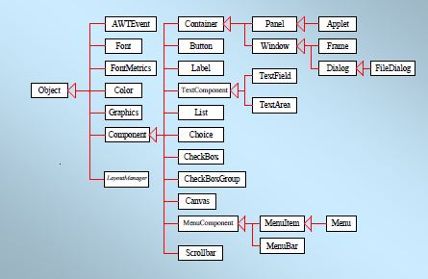
AWT Hierarchy

Slide 30
Events Handling
GUI components communicate with the rest of the applications through events.
The source of an event is the component that causes that event to occur.
The listener of an event is an object that receives the event and processes it appropriately.

Slide 31
Events Handling
Every time the user types a character or clicks the mouse, an event occurs.
Any object can be notified of any particular event.
To be notified for an event,
The object has to be registered as an event listener on the appropriate event source.
The object has to implement the appropriate interface.

Slide 32
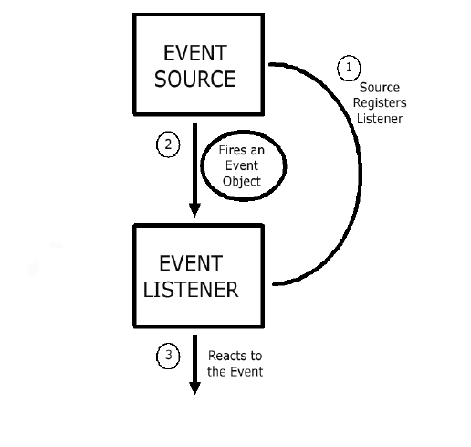
The Event Handling Process (contd..)

Slide 33
What does an Event Handler require?
It just looks for 3 pieces of code!
First, in the declaration of the event handler class, one line of code must specify that the class implements either a listener interface or extends a class that implements a listener interface.
public class DemoClass implements ActionListener {

Slide 34
What does an Event Handler require? (contd..)
Second, it looks for a line of code which registers an instance of the event handler class as a listener of one or more components because, as mentioned earlier, the object must be registered as an event listener.
anyComponent.addActionListener(instanceOf DemoClass);

Slide 35
What does an Event Handler require? (contd..)
Third, the event handler must have a piece of code that implements the methods in the listener interface.
public void actionPerformed(ActionEvent e) {
...//code that reacts to the action...
}

Slide 36
Types of Events
Below, are some of the many kinds of events, swing components generate.
Act causing Event | Listener Type
User clicks a button, presses Enter, typing in text field | ActionListener
User closes a frame | WindowListener
Clicking a mouse button, while the cursor is over a component | MouseListener

Slide 37
Types of Events (contd..)
Act causing Event | Listener Type
User moving the mouse over a component | MouseMotionListener
Component becomes visible | ComponentListener
Table or list selection changes | ListSelectionListener

Slide 38
The Event classes
An event object has an event class as its reference data type.
The Event object class
Defined in the java.util package.
The AWT Event class
An immediate subclass of EventObject.
Defined in java.awt package.
Root of all AWT based events.

Slide 39
Event Listeners
Event listeners are the classes that implement the
<type>Listener interfaces.
Example:
1. ActionListener receives action events
2. MouseListener receives mouse events.
The following slides give you a brief overview on some of the listener types.

Slide 40
The ActionListener Method
It contains exactly one method.
Example:
public void actionPerformed(ActionEvent e)
The above code contains the handler for the ActionEvent e that occurred.

Slide 41
The MouseListener Methods
Event handling when the mouse is clicked.
public void mouseClicked(MouseEvent e)
Event handling when the mouse enters a component.
public void mouseEntered(MouseEvent e)
Event handling when the mouse exits a component.
public void mouseExited(MouseEvent e)

Slide 42
The MouseListener Methods (contd..)
Event handling when the mouse button is pressed on a component.
public void mousePressed(MouseEvent e)
Event handling when the mouse button is released on a component.
public void mouseReleased(MouseEvent e)

Slide 43
The MouseMotionListener Methods
Invoked when the mouse button is pressed over a component and dragged. Called several times as the mouse is dragged
public void mouseDragged(MouseEvent e)
Invoked when the mouse cursor has been moved onto a component but no buttons have been pushed.
public void mouseMoved(MouseEvent e)

